Slide 1



Intro to PWN
MIT © 2018 Tiago Ferreira
Notes:
Start with introduction
Ask students to introduce themselves.
Emphasise the importance of asking questions and not be afraid of doing so.
The goal is to have fun while learning something new.
If you’re not having fun, let’s talk about it and see how we can change that.

Slide 2
Overview
What is PWM
Why do we need it
Arduino PWM ports
Hands-On Learning
MIT © 2018 Tiago Ferreira
Notes:
Start with a brief intro to PWM
It’s quite a complex thing so we don’t need to go into much detail
Then we’ll see why we need PWN in the arduino.
A quick demo of where the Arduino ports are located.
Hands-On Learning -> Changing the brightness of an LED with a potentiometer.

Slide 3
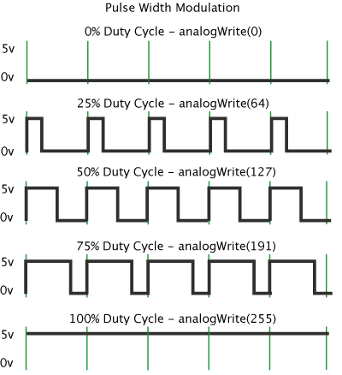
What is PWM
Stands for Pulse Width Modulation
A way to change how much electricity is provided.
MIT © 2018 Tiago Ferreira

Slide 4
Why do we need it
PWM is used for when we want things to be neither on or off but something in the middle.
It can be used to dim LEDs.
Provide analog output.
Generating audio signals.
Providing variable speed to motors.
MIT © 2018 Tiago Ferreira

Slide 5
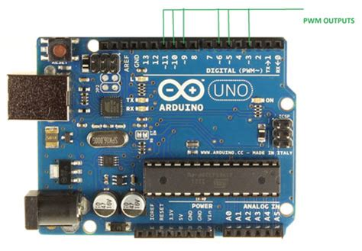
Arduino PWM ports
MIT © 2018 Tiago Ferreira

Slide 6
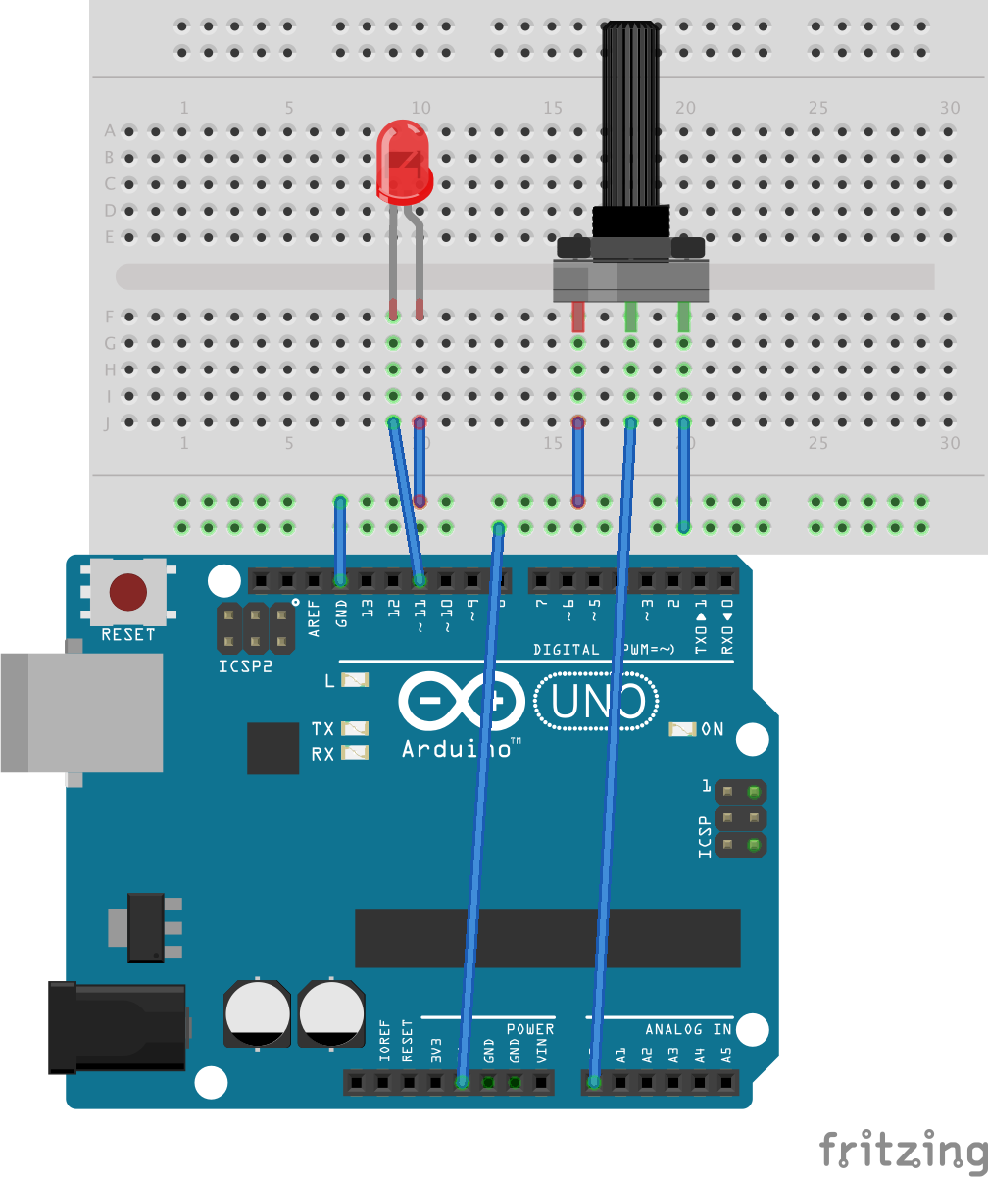
Hands-on Learning
MIT © 2018 Tiago Ferreira

